Slide 1
SPRINT 2 DEMO – CCP TOUR APP
Gerardo Flores, Ahram Kim

Slide 2
VISUAL HIERARCHY APP DESIGN
About
default page
Splashscreen
Home
Splash screen for
Boise State University
Computer Science
About
Map
Home
Map

Slide 3
VISUAL HIERARCHY APP DESIGN
Introduction
Ecosystem
About
Introduction
Ecosystem
About
About
. . . .
Contact us
Contact us
About
About

Slide 4

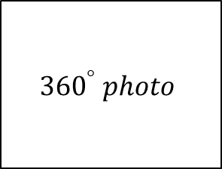
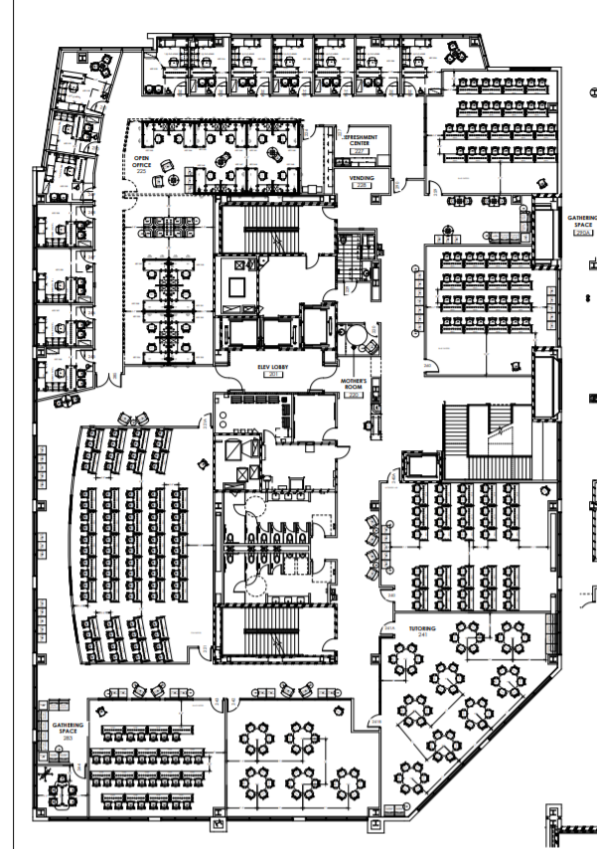


VISUAL HIERARCHY APP DESIGN
Map
CCP 221
2nd floor
2nd floor
3rd floor
Ccp221 INFO
Map
Map
Map
Map

Slide 5

Notes:
This happened because we initialized a new github repo with README or LICENSE file. We should have to merge those new initialized files with our work. ‘git pull’ fetches and merges.

Slide 6
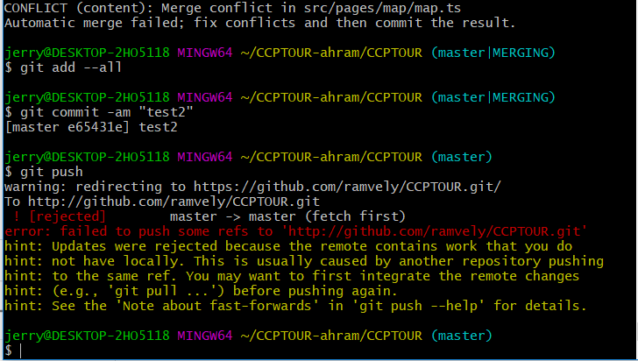
GIT MERGING CONFLICT
Notes:
Following the error, we followed the instructor ‘git pull’ and got another error about git merge conflict.
http://stackoverflow.com/questions/24357108/git-updates-were-rejected-because-the-remote-contains-work-that-you-do-not-have/43574620

Slide 7
GIT MERGING CONFLICT
This happened because we initialized a new github repo with README or LICENSE file. We should have to merge those new initialized files with our work. ‘git pull’ fetches and merges.
According to the stactoverflow.com/questions/24357108/git-updates-were-rejected-because-the-remote-contains-work-that-you-do-not-have, git pull <remote> master:dev will fetch the remote/master branch and merge it into your local/dev branch. Git pull <remote> dev will fetch the remote/dev branch, and merge it into your current branch. The conflicting commit was on remote/dev, so that is the branch he probably intended to fetch and merge.

Slide 8
DEFINITION OF DONE
All acceptance criteria have been met
We designed visual hierarchy app design
We made three navigator tabs
We start the ‘home’ tab for the user
All the automated tests for the user story run without failing and any defects
Code unit tested
Pair programming is done
Build pushed to demo server

Slide 9
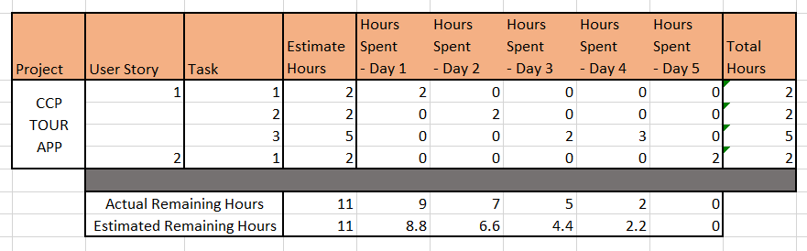
BURNDOWN CHART

Slide 10
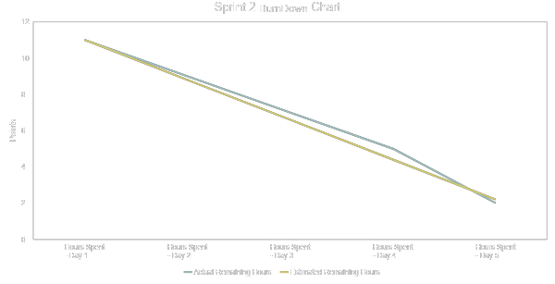
BURNDOWN CHART

